Slide 1
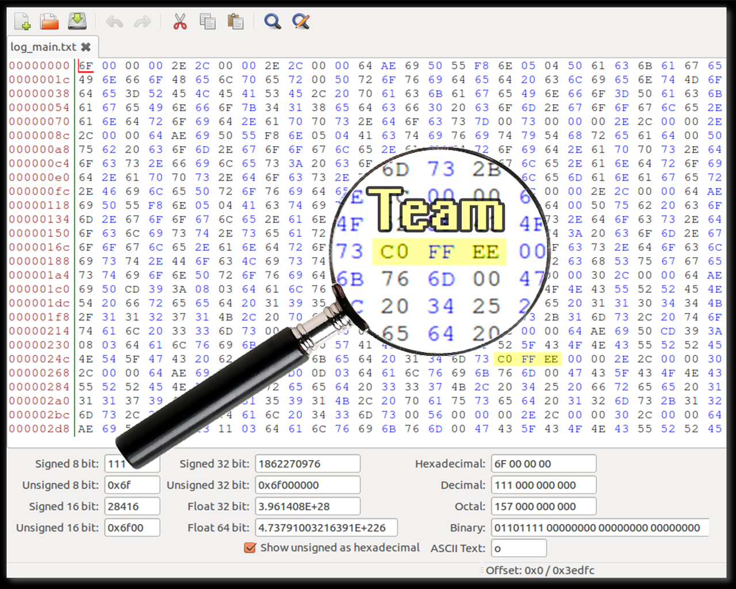

Slide 2

Team 0xC0FFEE
Chris Woodard, Adam Lowther, Robert Ries

Slide 3
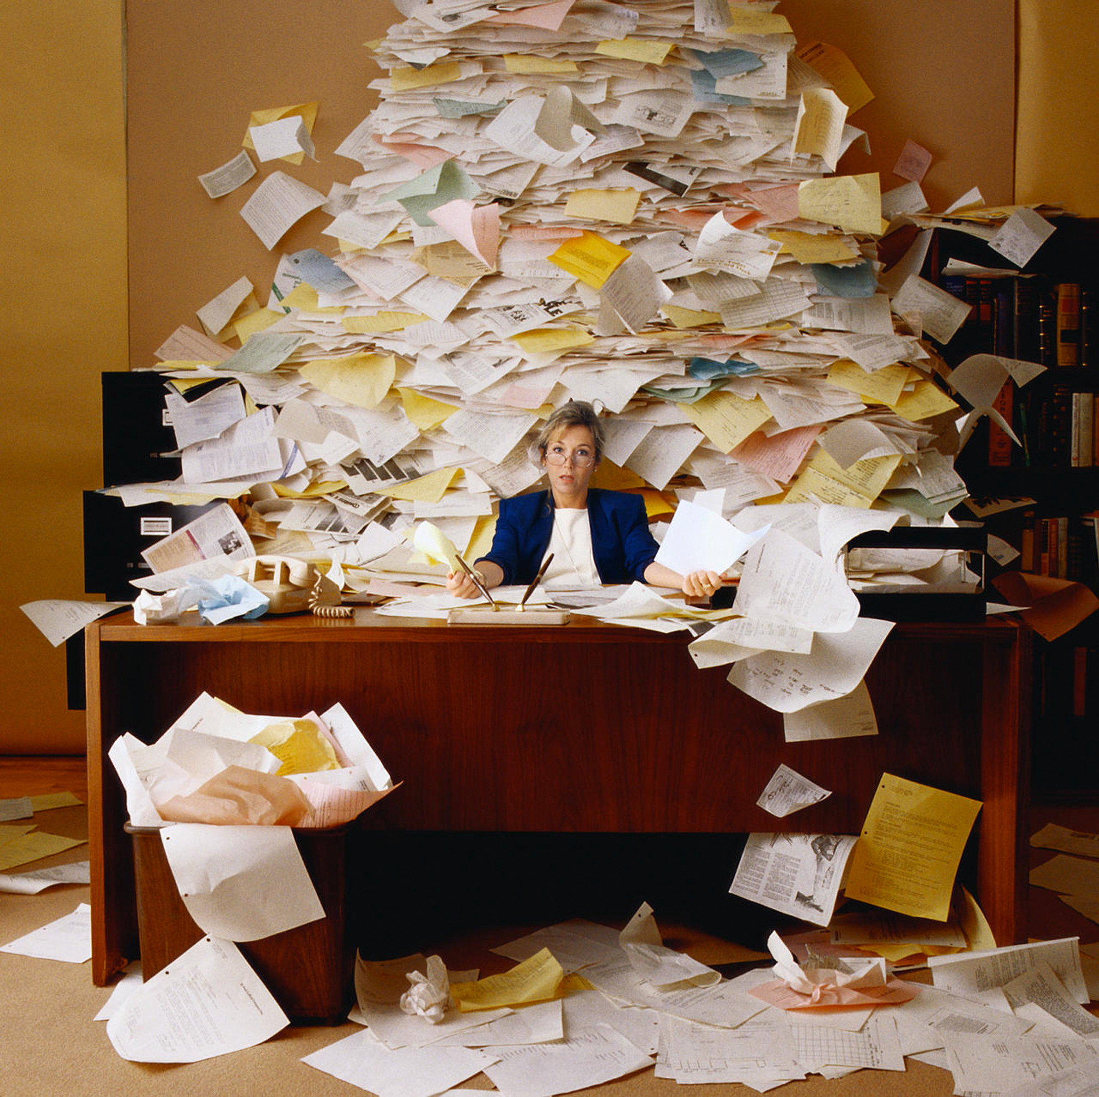

Slide 4

theproblem:
Barriers of entry
Which route do I want?
When does the bus come?
What bus should I get on?

Slide 5
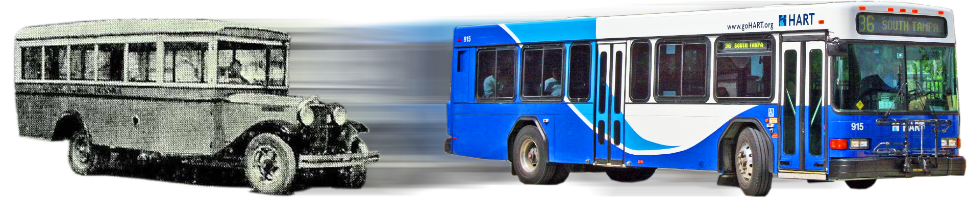
wethink:
Public transportation needs a makeover

Slide 6
thesolution:
A smart phone application that:
Provides dynamic route options
Gives a list of the routes
Generates a map of all bus paths

Slide 7
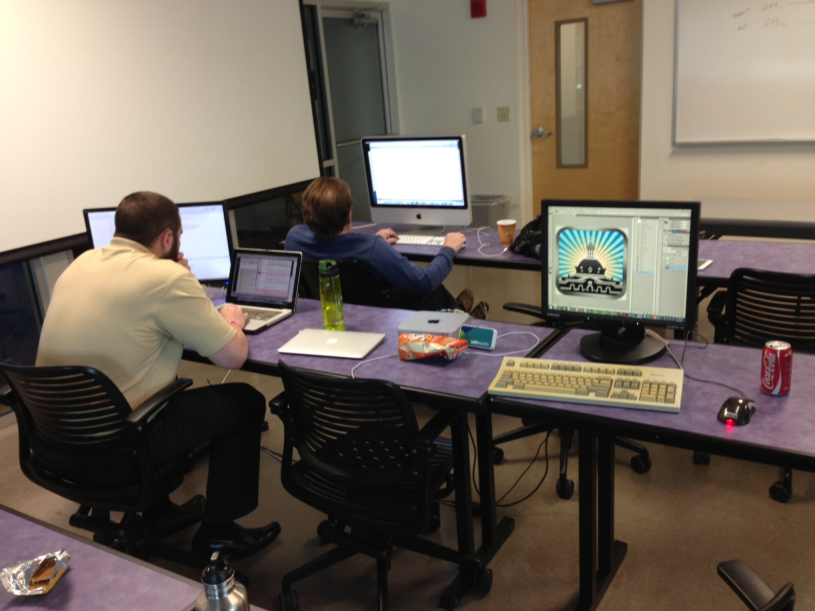
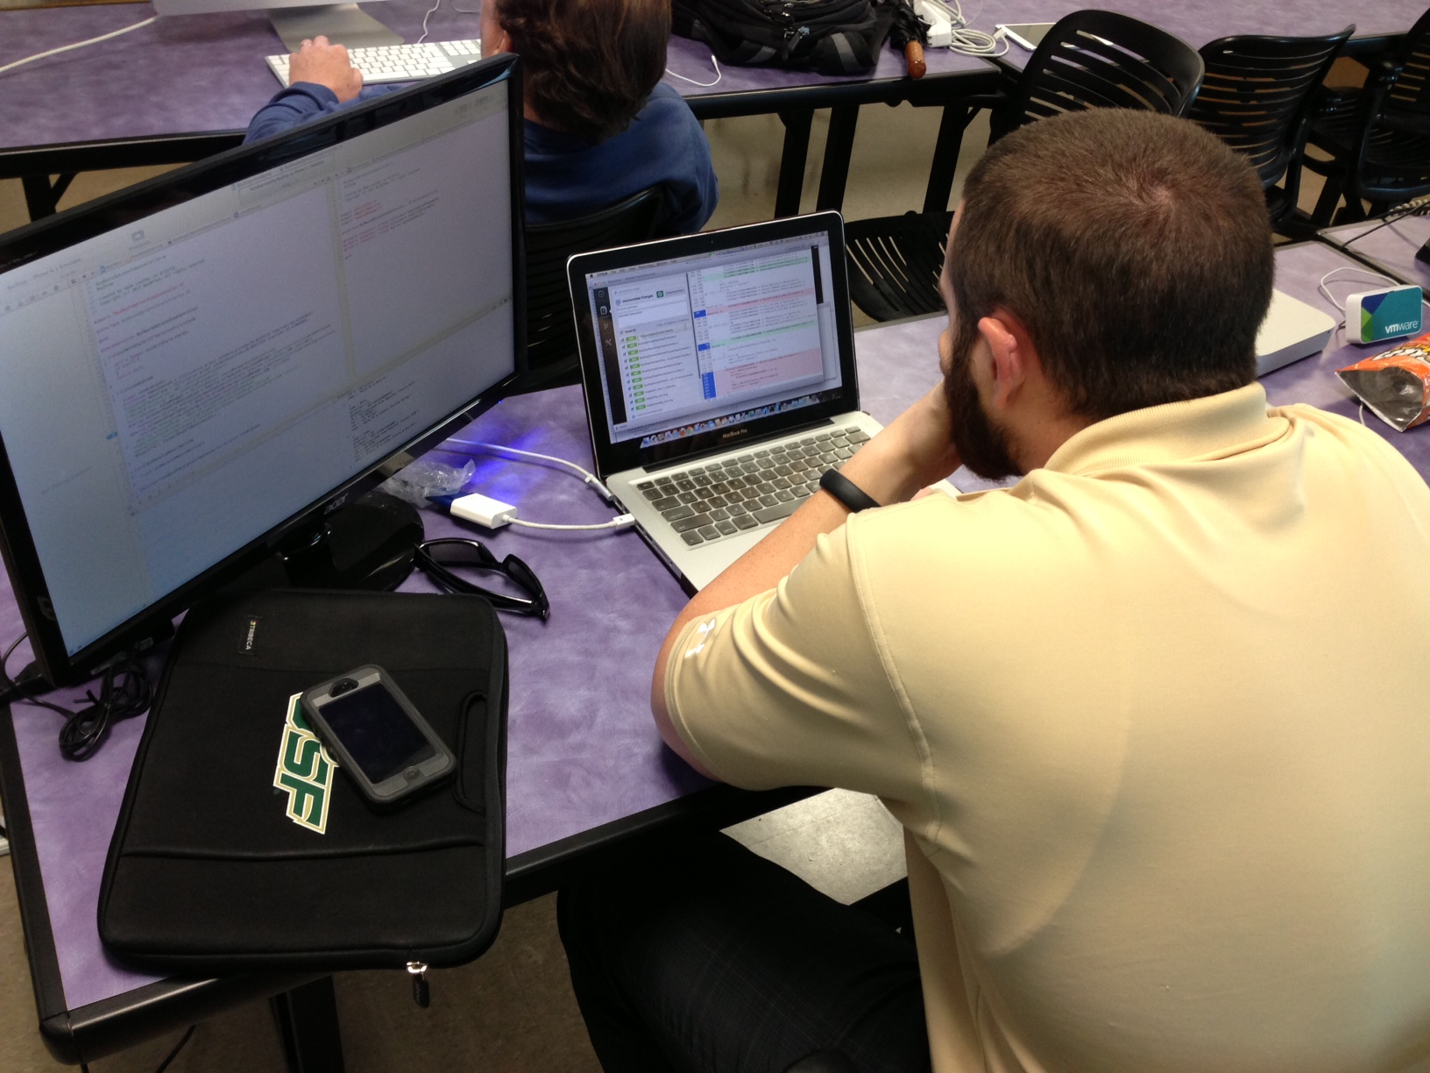

Slide 8

thesolution:

Slide 9

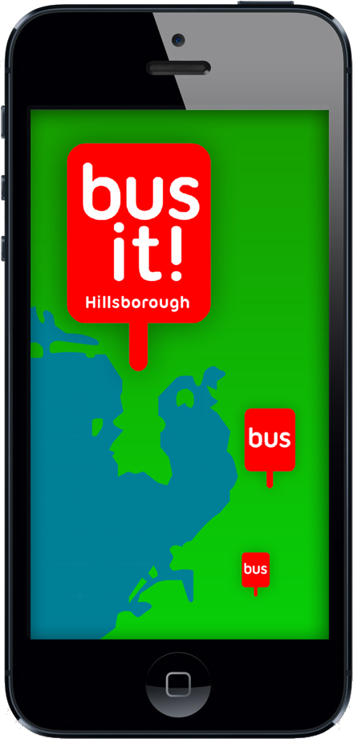
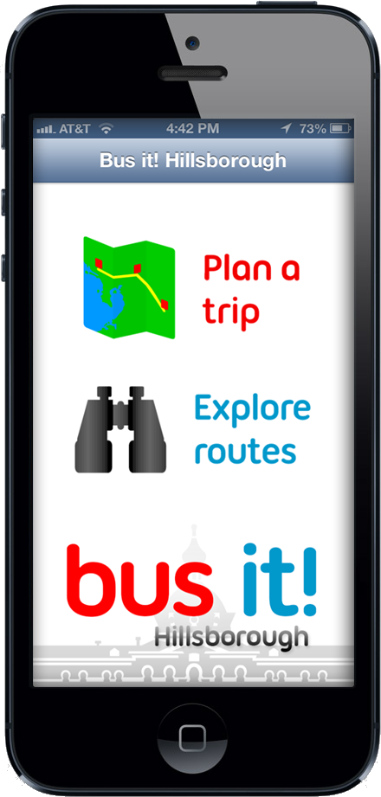

Slide 10
thankyou!

